Slide 1
Breeding Dogs Activity
You will need a sheet of paper, a writing utensil, and a coin.

Slide 2
Assignment:
You are a dog breeder. You have been contacted by a scientist who wants dogs that could be used to see and retrieve waterfowl (ducks and geese) from lakes in the area so the birds can be tagged and re-released. The birds are very skittish (scare easily) and must be retrieved unharmed and with a minimum amount of stress. In order to complete this task you will:
select which traits the off spring will need to display
select the two breeds you will use to mate and produce pups
Determine the traits inherited by the offspring
select the offspring (puppy) who displays the best traits for the scientist’s needs.

Slide 3
1. Select the traits the offspring will need Write the desired form of the feature listed below you ideally would like the offspring to have. For features you do not think will affect the breed’s ability to perform the given task, write “any”.
Physical Feature | Desired Form
Smell | Above average | Average | Below Average | Any
2. Sight | Above average | Average | Below Average | Any
3. Hearing | Above average | Average | Below Average | Any
4. Speed | Above average | Average | Below Average | Any
5. Endurance | Above average | Average | Below Average | Any
6. Strength | Above average | Average | Below Average | Any
7. Coat Color | Very Dark | Average | Very Light | Any
8. Hair Length | Long | Average | Short | Any
Behavioral Feature | Desired Form
9. Trainability | High | Average | Low | Any
10. Disposition | Vicious | Compatible | Meek | Any
11. Bark | Very Loud | Average | Very Quiet | Any

Slide 4
Questions:
1. How can you determine which forms of the desired trait would be best for the offspring?

Slide 5
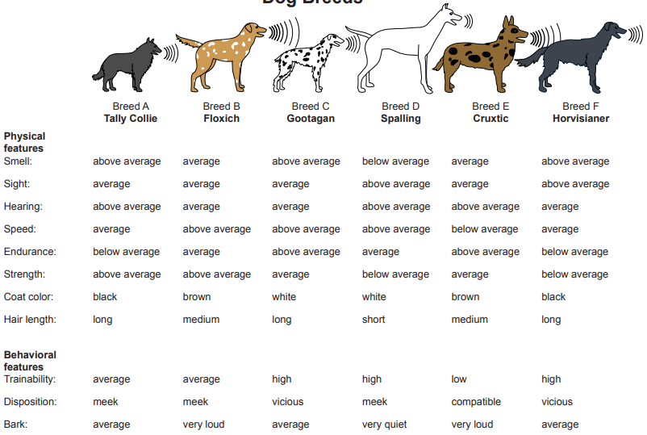
2. Select the two breeds who have the desired traits Use the chart below to determine which two breeds have the desired traits and would be most appropriate to breed. Write the two breeds you have chosen to mate on your paper.
Breeds Chosen to Mate:
_____________ X _______________

Slide 6
Questions:
2. How do you determine which two breeds should be used to mate and produce offspring?

Slide 7
3. Determine the traits inherited by the Puppies Use your coin and dog breed chart on slide 5 to determine which trait each pup will inherit. For each feature listed flip the coin. If the coin lands “heads” the puppy will receive the trait from the first chosen breed. If the coin lands “tails” the puppy will receive the trait from the second chosen breed. Do this for all three puppies.
Physical Feature | Puppy #1 | Puppy #2 | Puppy #3
Smell
2. Sight
3. Hearing
4. Speed
5. Endurance
6. Strength
7. Coat Color
8. Hair Length
Behavioral Feature
9. Trainability
10. Disposition
11. Bark

Slide 8
Question:
3. How do you know which puppy is going to be the best for the scientist to use in the waterfowl project?
4. In this activity the puppy had a 25% chance of inheriting each trait (smell, sight, hearing, etc). Is this true in real life?

Slide 9
Example Answers #1 This is only one variation of possible answers.
Physical Feature | Desired Form
Smell | Above average | Average | Below Average | Any
2. Sight | Above average | Average | Below Average | Any
3. Hearing | Above average | Average | Below Average | Any
4. Speed | Above average | Average | Below Average | Any
5. Endurance | Above average | Average | Below Average | Any
6. Strength | Above average | Average | Below Average | Any
7. Coat Color | Very Dark | Average | Very Light | Any
8. Hair Length | Long | Average | Short | Any
Behavioral Feature | Desired Form
9. Trainability | High | Average | Low | Any
10. Disposition | Vicious | Compatible | Meek | Any
11. Bark | Very Loud | Average | Very Quiet | Any

Slide 10
Example Answer #2 Breed selection is based off answers on slide 11. This is only one variation of possible answers.

Slide 11
Example Answers #3 Puppy trait inheritance is based off answers on slide 12. This is only one variation of possible answers.
Physical Feature | Puppy #1 | Puppy #2 | Puppy #3
Smell | Below Average | Average | Below Average
2. Sight | Above average | Above average | Above average
3. Hearing | Average | Above average | Average
4. Speed | Above average | Above average | Above average
5. Endurance | Average | Average | Average
6. Strength | Above Average | Above Average | Above average
7. Coat Color | Brown | White | Brown
8. Hair Length | Short | Medium | Short
Behavioral Feature
9. Trainability | High | High | High
10. Disposition | Meek | Meek | Meek
11. Bark | Very loud | Very quiet | Very quiet

Slide 12
Question Answers: (do not look at this slide unless you have answered all the questions)
How can you determine which forms of the desired trait would be best for the offspring? The forms of the traits should be determined by the task the dog needs to perform. For example, the dog needs above average sight to see the birds and high trainability in order for the scientist to teach the dog how to retrieve the birds.
How do you determine which two breeds should be used to mate and produce offspring? The two breeds chosen should have the majority of the necessary traits to perform the task. For example Breed D has above average sight and high trainability. Breeds that are vicious may not be a good choice because the birds must be unharmed. There is more than one combination of breeds that could produce pups with desirable traits.

Slide 13
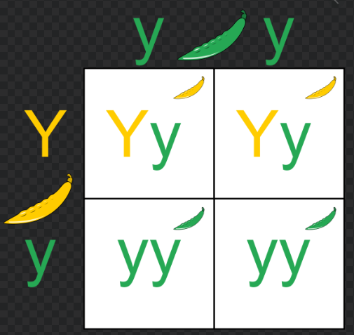
Question Answers: (do not look at this slide unless you have answered all the questions)
3. How do you know which puppy is going to be the best for the scientist to use in the waterfowl project? Puppy selection should be based on desirable traits. The puppy with the most desirable traits should be chosen for the scientist.
4. In this activity the puppy had a 50% chance of inheriting each trait (smell, sight, hearing, etc). Is this true in real life? Not all traits have a 50% chance of being passed onto offspring. Dominate traits may be displayed by an organism, but recessive traits can still be passed to offspring if the parents have heterozygous alleles.

